Slide 1
Live-Cell Tracking using Phase Stretch Transform
Mark Kubiak (305629112)
Tristan Melton (504727735)
Can Vu (105428237)
Notes:
Speaker: Mark

Slide 2
Division of Labor
Can
PST algorithm research
Slide deck (background)
Mark
Dataset import, visualization
Cell centroid detection
Cell tracking
N-dimensional PST port
Tristan
Cell centroid detection
Cell tracking
Initial 3D PST
Initial Data visualization
Notes:
Speaker: Mark

Slide 3
Outline
Introduction
Background
Phase Stretch Transform
PST Mathematical Description
Project
Code Overview
3D PST and Processing
Centroid Detection
Centroid Tracking
Results
Dataset
Results, overlay image and PST
Conclusion
Future Work
Notes:
Speaker: Mark

Slide 4
Background
Feature detection plays a critical role in solving problems such as object recognition, image restoration, and pattern recognition
Goal is to have accurate classification while also being robust to various viewing conditions, i.e. fog, lighting, zoom factor, etc
Obstructive environmental conditions can create bottlenecks in computer vision applications
Technologies such as High Dynamic Range (HDR) hold promise to alleviate some of these problems
Its slow frame rate creates challenges in real-time applications, e.g. autonomous vehicles
Phase Stretch Transform (PST) technique developed as a novel approach to feature detection that has potential for resolving these problems
Notes:
Speaker: Can

Slide 5
Phase Stretch Transform: Introduction
Physics-inspired, computational approach to signal and image processing with applications to feature detection and classification
Transforms an image by emulating propagation of EM waves through a diffractive medium with frequency dependent refractive index
Phase of the transform has properties useful for detection of edges and sharp transitions of an image
PST functionally operates similarly to phase-contrast microscopy
Has roots in photonic phase time stretch technique
Employs temporal dispersion to slow down, capture, and digitally process fast waveforms in real time
Inherent equalization ability that gives a response ideal for feature detection in low contrast, visually impaired images
Notes:
Speaker: Can PST is a fundamentally different approach to algorithm design. Whereas algs in CS are designed by mathematics, the PST seeks to emulate physics and apply it to imaging
Equalization ability will be discussed in more detail in a later slide.

Slide 6
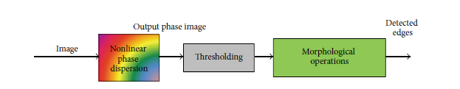
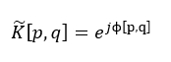
Phase Stretch Transform: Mathematical Description
Input image is smoothed using a localization kernel and passed through a 2D, nonlinear, frequency-dependent phase function
PST in 2D can be described in the frequency domain as
Warped phase kernel operation in frequency domain (K) , frequency response of localization (L)
ɸ is the PST phase kernel
Diagram from: M. H. Asghari and B. Jalali, “Edge Detection in Digital Images Using Dispersive Phase Stretch Transform,” International Journal of Biomedical Imaging, vol. 2015, p. e687819, Mar. 2015, doi: 10.1155/2015/687819.
Notes:
Speaker: Can
-P and q are two dimensional frequency variables and pst(E…) is the phase image
-
-The function L is the frequency response of the localization kernel and K is the frequency dependent phase kernal
--Phase image is further postr processed. For edge detection, this includes cutting the negative phase values, thresholding, and morphological operations

Slide 7
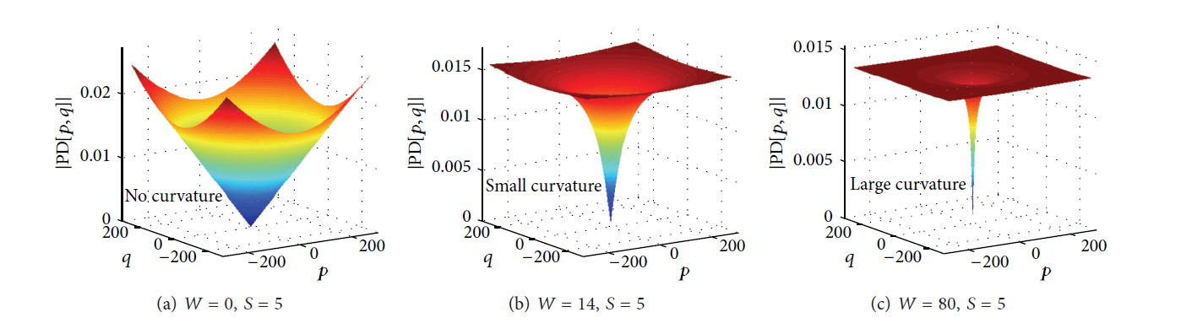
Phase Stretch Transform: Mathematical Description
Bandwidth of Localization kernel used to used to reduce the noise in the proposed edge detection algorithm while preserving edge information
Typical phase derivative profiles resulting in edge detection:
Phase kernel applies phase which increases in spatial frequency
Since edges have high frequencies, larger phases are assigned to the edges, accentuating the edges in the transformed image
Diagram from: M. H. Asghari and B. Jalali, “Edge Detection in Digital Images Using Dispersive Phase Stretch Transform,” International Journal of Biomedical Imaging, vol. 2015, p. e687819, Mar. 2015, doi: 10.1155/2015/687819.
Notes:
Speaker: Can
-P and q are two dimensional frequency variables and A is the phase image
-
-The function L is the frequency response of the localization kernel and K is the frequency dependent phase kernal

Slide 8
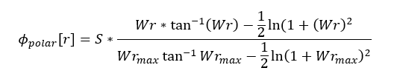
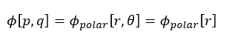
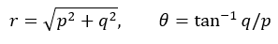
Phase Stretch Transform: Mathematical Description
Use phase kernels where kernel phase derivative 𝑃𝐷[𝑝, 𝑞] is a linear or sublinear function with respect to frequency variables for simplicity
Inverse tangent function as choice
W: warp parameter, S: strength parameter, rmax: maximum frequency
Assumed PST kernel has circular / spherical symmetry w.r.t frequency variables
S, W, thresholding and bandwidth of localization kernel are used to tune and extract edge information
Larger S: better noise performance, lower spatial resolution
Larger W: sharper edge, higher edge noise
The output of PST is inversely related to the brightness (valid for small phase)
Output is larger for lower light regions of the image
This property equalizes the input brightness and allows for more sensitive feature detection
Equation from: M. H. Asghari and B. Jalali, “Edge Detection in Digital Images Using Dispersive Phase Stretch Transform,” International Journal of Biomedical Imaging, vol. 2015, p. e687819, Mar. 2015, doi: 10.1155/2015/687819.
Notes:
Speaker: Can
E[x] here is the brightness
PST is a reconfigurable operator that can be tuned to detect certain features
Slide wrap-up: PST detects sharp phase transitions in image with tunability for noise performance and resolution

Slide 9
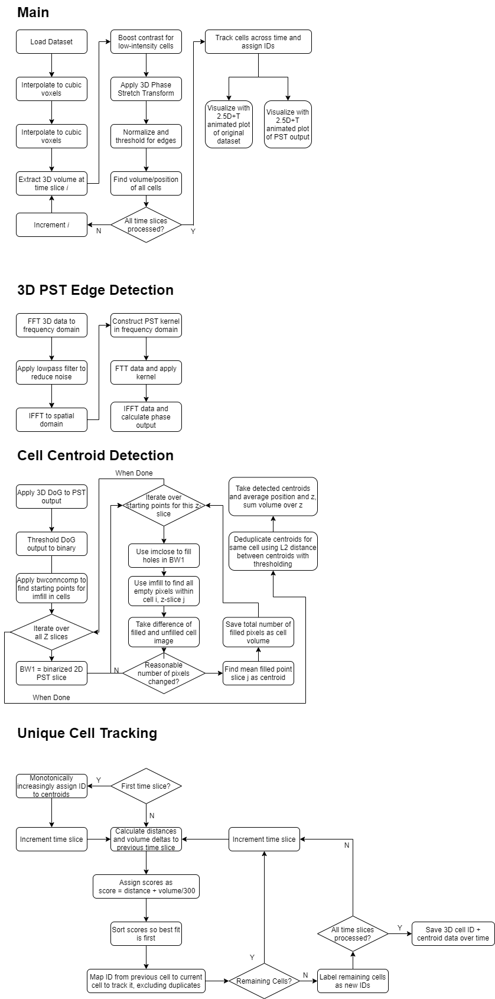
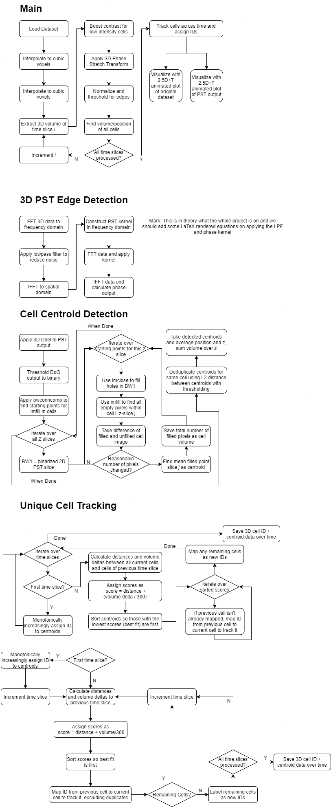
Code Overview
Notes:
Speaker: Mark

Slide 10
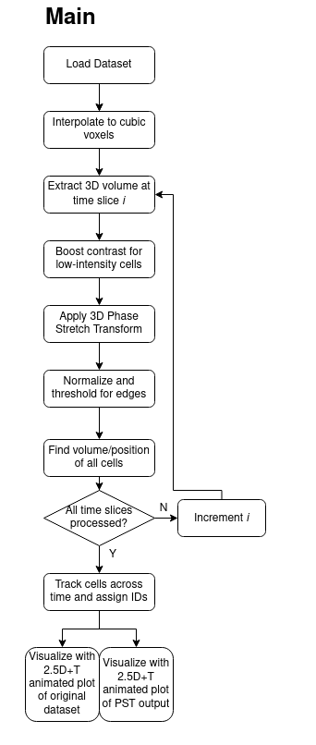
File Names | Input(s) | Output(s)
cell_dataset.m | Root folder | 3D+Time dataset
PST_pre.m | 3D Volume, PST options | Contrast boosted 3D volume
PST_ND.m | 2D/3D Data, PST options | PST features, PST kernel
PST_post.m | PST features, PST options | Binarized edges
find_cells.m | Binarized edges, DoG sigmas, Z scale for voxels | Centroid structs
track_cells.m | Centroid structs | Centroid structs with IDs
visualize_2p5d_T.m | Filename, 3D+Time data, centroid struct, plot shape | .gif file to disk
Notes:
Speaker: Mark

Slide 11
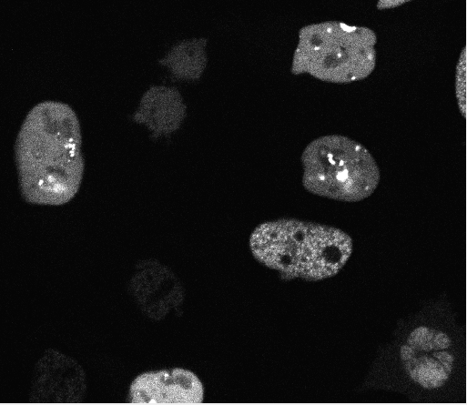
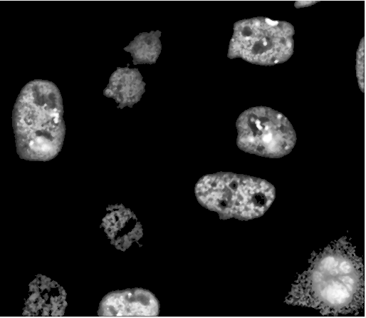
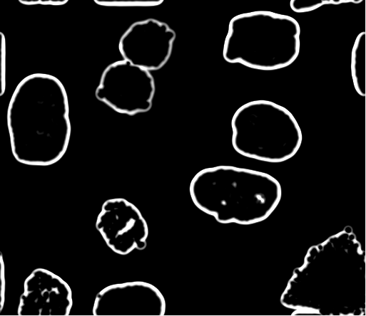
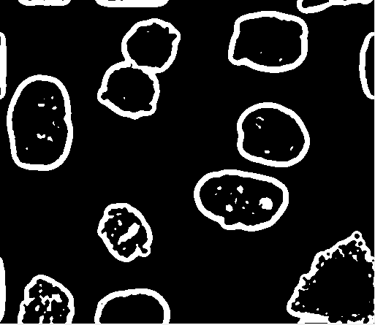
3D PST and Processing
PST extension over third axis
Create third axis, expand rho into 3D
Expand from fft2 to fftn and ifft2 to ifftn for n-dimensional PST
Image passed through pre-processing to enhance low-contrast cells and reduce noise
Thresholding, average filter, median filtering, CLAHE
Post-processing and binarization of image
Post-Processing + Binary Threshold
Raw Image
Pre-Processing
PST
Notes:
Speaker: Mark

Slide 12
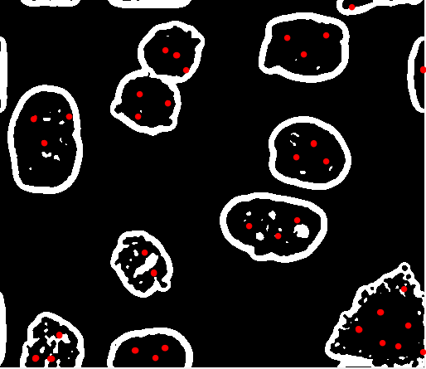

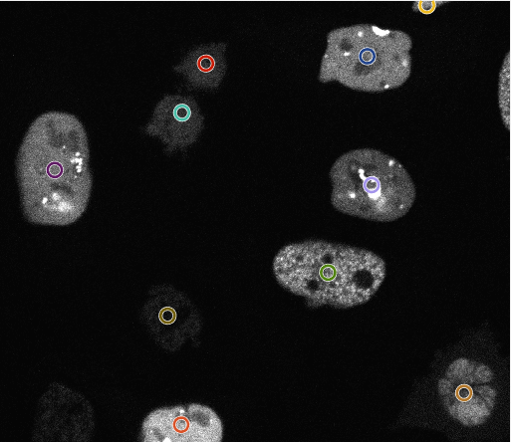
Centroid Detection
Find points in cell
Use image fill algorithm per-point, with detection of out-of-cell fills
Use number of pixels filled as area, find centroid per-slice
Find nearby centroids in each slice and use slice height as z component to find final centroid
Post-Processed PST, Binary Threshold
Image Fill Algorithm
Detect Centroids
Notes:
Speaker: Tristan (initial centroids), Mark (final centroids)

Slide 13
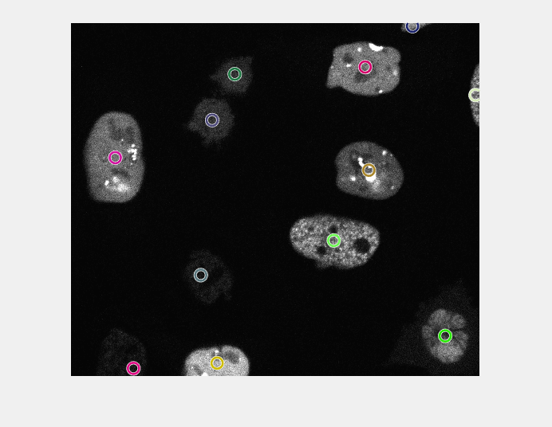
Centroid Tracking
Compare current timestep centroids with previous timestep
Take distance and volume deltas with each centroid to establish match scores
Take best score as that cell and give it the cell’s ID
If cell has no match with previous timestep, assume it is a new cell from a splitting event or drifting into frame
Notes:
Speaker: Tristan, Mark

Slide 14
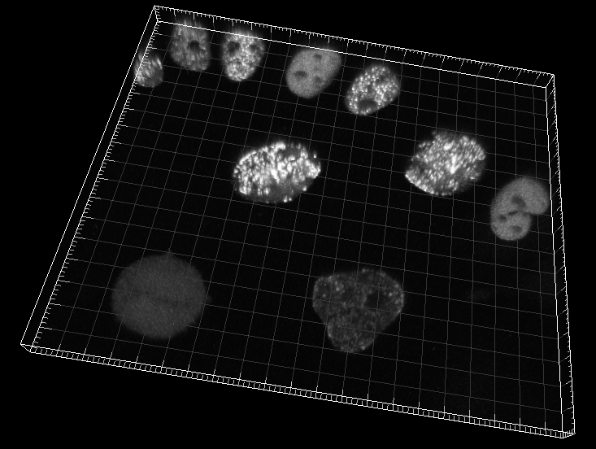
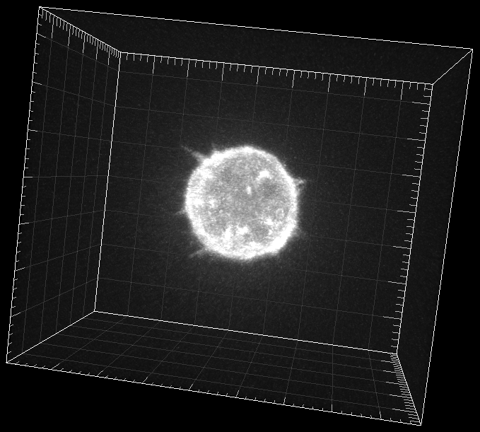
Dataset
3D+Time data from http://celltrackingchallenge.net/3d-datasets/
Fluo-N3DH-CHO
Generally spherical cells moving over time
Includes splitting events
Cells present in all z slices - centroids estimated to be usually in 3rd z slice
Fluo-C3DH-A549
Single large spherical cell with cell edge perturbation / flagella
Cell present in only some z slices
Correctly detect and place centroid in middle cell z slice
Notes:
Speaker: Mark

Slide 15
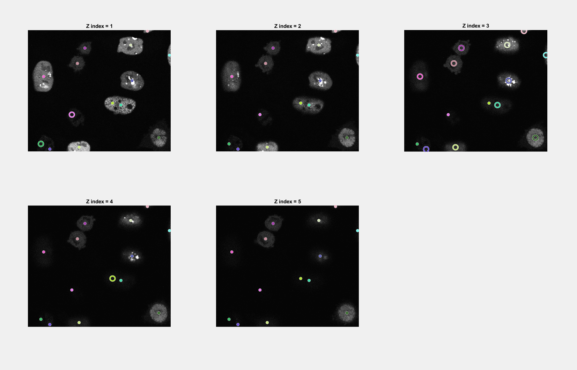
Results - Fluo-N3DH-CHO Dataset
Strong PST edge detection
Generally strong centroid detection
Faded cells are less likely to be detected
Strong positional tracking with time
Small dots shown at x/y position for all Z slices
Rings shown at x/y position for detected Z index (3D centroid)
Notes:
Speaker: Tristan

Slide 16
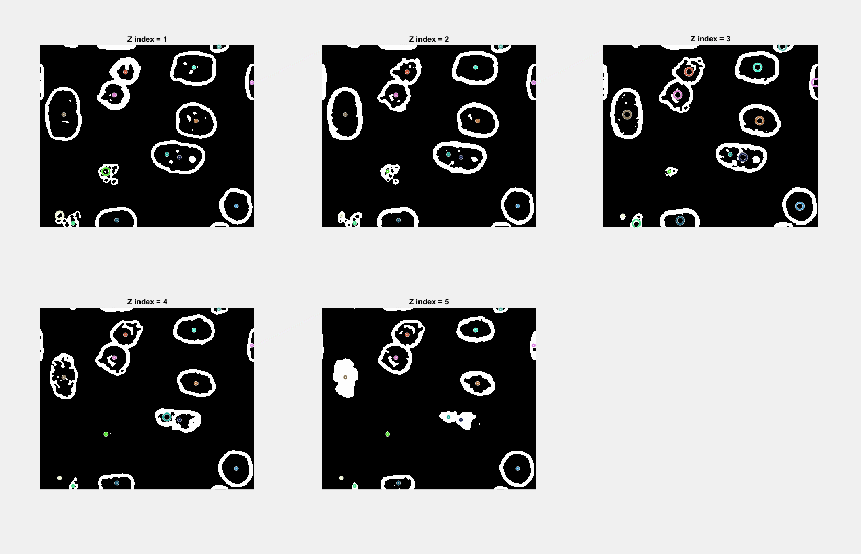
Results - Fluo-N3DH-CHO Dataset
Strong PST edge detection
Generally strong centroid detection
Faded cells are less likely to be detected
Strong positional tracking with time
Small dots shown at x/y position for all Z slices
Rings shown at x/y position for detected Z index (3D centroid)
Notes:
Speaker: Tristan

Slide 17
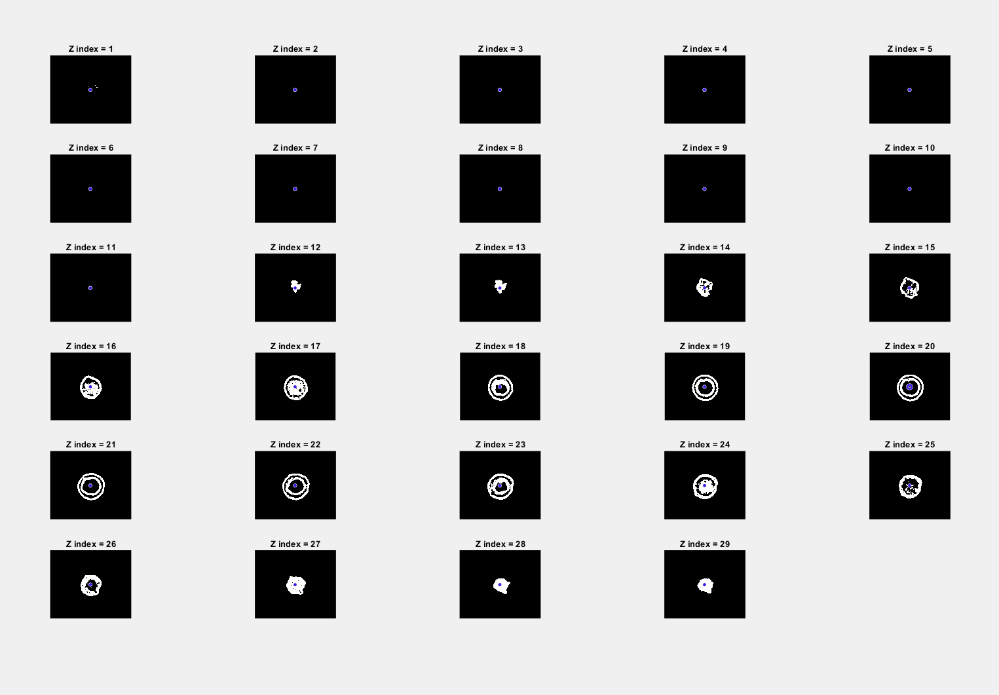
Results - Fluo-C3DH-A549 Dataset
Strong PST edge detection
Strong centroid detection
Strong positional tracking with time
Low jitter for Z axis centroid position (Z=20 to Z=22)
Notes:
Speaker: Tristan

Slide 18
Conclusion
PST is a viable method of edge detection
ideal for visualization or sharp transitions (high phase difference)
Cell identification can be performed with DoG and imfill algorithms for better centroid detection
Room for improvement - better pre processing for image enhancement and noise reduction
Cell tracking performed via score system utilizing centroid position and cell volume
Notes:
Speaker: Mark

Slide 19
Future Work
Automatic tuning of PST parameters for specific use cases
Large-edge detection
detail feature detection
Improvement of low-contract cell enhancement and noise filtering
Compare PST to various types of Convolutional Neural Networks (CNNs)
Reduce noise inside cells for more resilient 3D implementation of fill algorithm
Stronger detection between cells above each other in the z-axis
Notes:
Speaker: Mark

Slide 20
Works Cited
M. H. Asghari and B. Jalali, “Edge Detection in Digital Images Using Dispersive Phase Stretch Transform,” International Journal of Biomedical Imaging, vol. 2015, p. e687819, Mar. 2015, doi: 10.1155/2015/687819.
M. Suthar, H. Asghari, and B. Jalali, “Feature Enhancement in Visually Impaired Images,” IEEE Access, vol. 6, pp. 1407–1415, 2018, doi: 10.1109/ACCESS.2017.2779107.
M. H. Asghari and B. Jalali, “Physics-inspired image edge detection,” in 2014 IEEE Global Conference on Signal and Information Processing (GlobalSIP), Dec. 2014, pp. 293–296. doi: 10.1109/GlobalSIP.2014.7032125.

